Slide 1
python CAPSTONE PROJECT otp generation
Presented By:
Manish Kumar Singh
S7616

Slide 2
INTRODUCTION
In this project, we have generated a 6 digits One Time Password to be sent through email to the user and it will be verified once the user enters it. If he enters the wrong OTP, he shall be given two additional attempts.

Slide 3
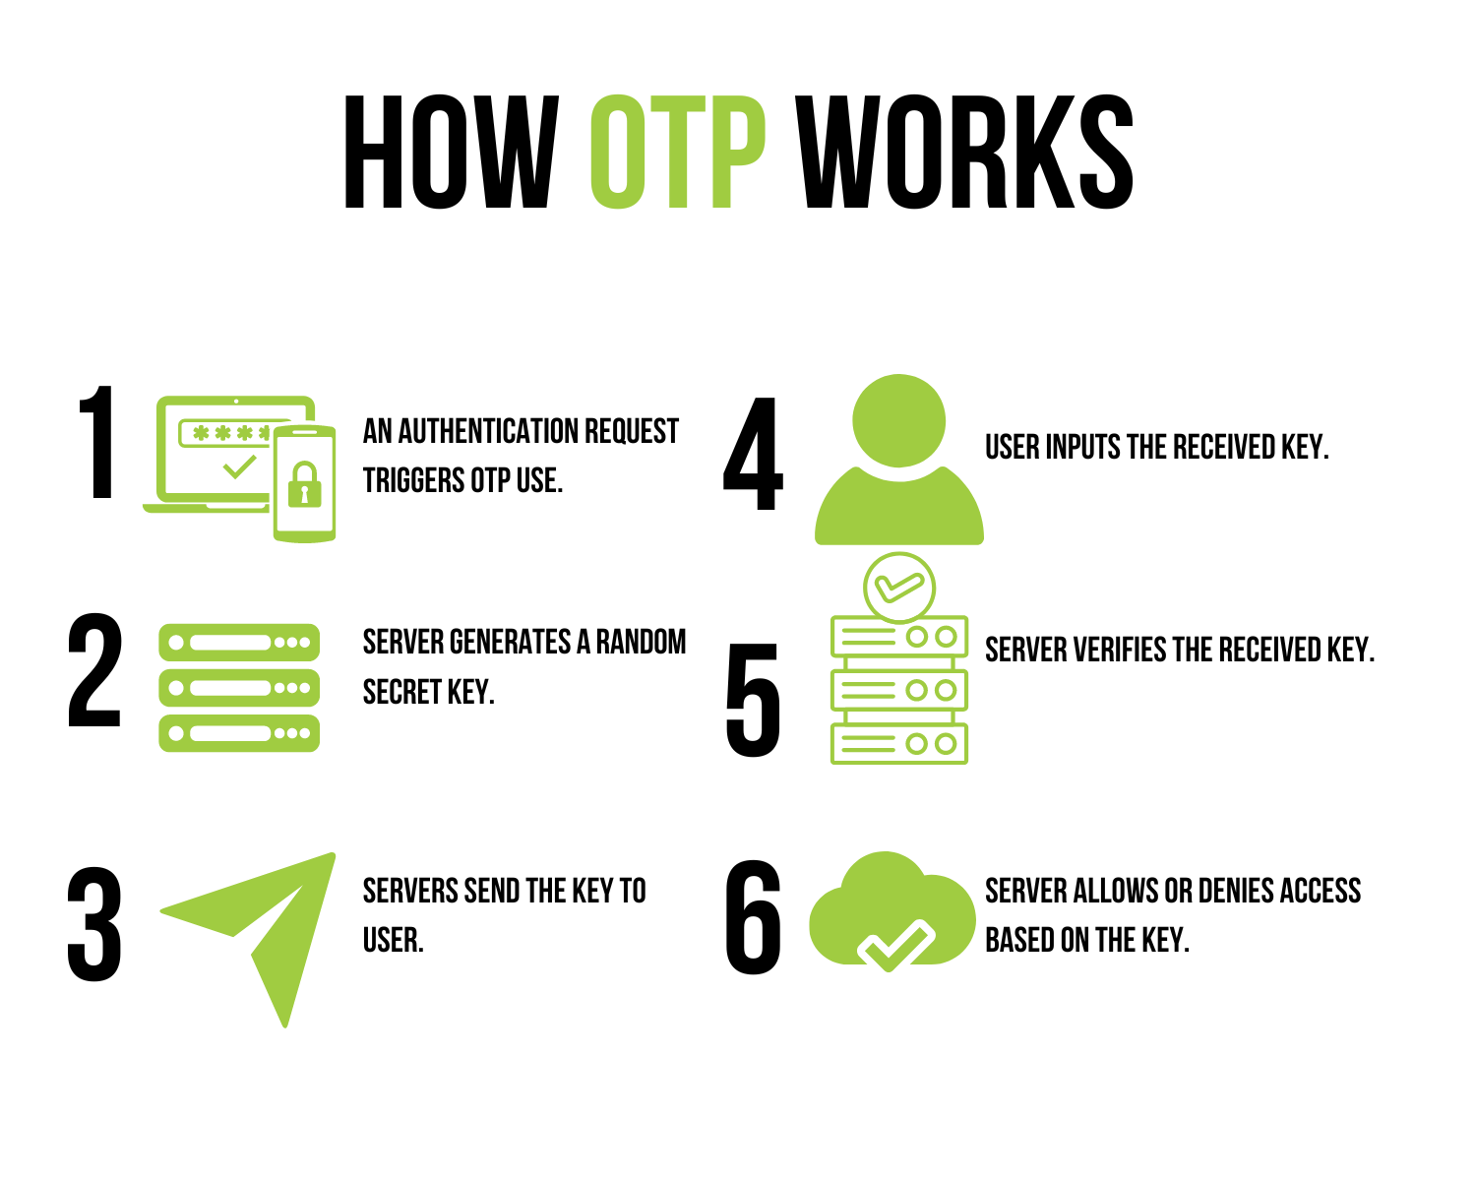

Slide 4
IDE USED
Google Colab

Slide 5
PROJECT REQUIREMENTS
Implement a function to generate a 6-digit OTP randomly.
Develop a function to simulate sending the OTP to the user's email address.
Create a function to prompt the user to enter the OTP received in their email.
Implement a function to verify if the entered OTP matches the generated OTP.
Ensure proper error handling and user-friendly prompts throughout the system.

Slide 6
Libraries used
import random – to generate a random 6 digit OTP
Import smtplib – sending email to the user

Slide 7

Function to generate otp

Slide 8
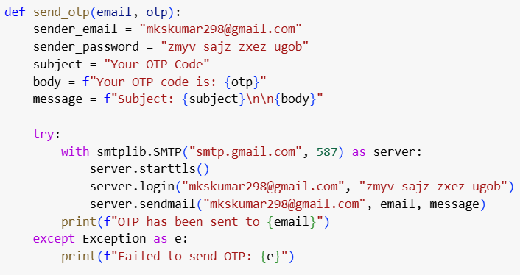
Function to send to the email id

Slide 9
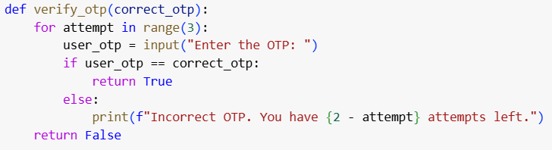
Function to verify otp

Slide 10
Thank you

